Slide 1


SWARNA BHARATHI
INSTITUTE OF SCIENCE & TECHNOLOGY
(Approved by AICTE, Govt. of TS& Affiliated to JNTUH, Hyderabad)
DEPARTMENT OF COMPUTER SCIENCE & ENGINEERING
MAJOR PROJECT SEMINAR PRESENTATION
ON
"SKIN DISEASE DETECTION AND CLASSIFICATION
USING DEEP LEARNING ALGORITHMS"

Slide 2

Guided By :
Submitted By:
MOHAMMAD ABDUL MUQEETH 19M61A0586
SHAIK SOHAIL FARHATH 19M61A05A3
KESA ARUN KUMAR 20M65A0505
S.SARITHA _{M.Tech (ph.d)}
Assistant professor

Slide 3
CONTENTS
ABSTRACT
INTRODUCTION
LITERATURE SURVEY
MODULES & WORKING OF CNN
CONCLUSION
REFERENCES
SYSTEM DESIGN
SYSTEM ANALYSIS
TESTING
OUTPUT SCREENS

Slide 4
ABSTRACT
Skin disease among humans has been a common disease, millions of people are suffering from various kinds of skin diseases. Usually, these diseases have hidden dangers which lead to not only lack of self-confidence and psychological depression but also lead to a risk of skin cancer. Medical experts and high-level instruments are needed to diagnosis these skin diseases due to non-availability of visual resolution in skin disease images. The proposed framework includes deep learning techniques such as CNN architecture and three predefined models called Alex Net, ResNet, InceptionV3. A Dataset of images with seven diseases has been taken for the Classification of Skin diseases. They include diseases like Melanoma, Nevus, Seborrheic Keratosis etc. The dataset was extended by adding images having cuts and burns, which were classified as skin disease by most of the existing systems. The usage of Deep Learning algorithms has reduced the need for human labor, such as manual feature extraction and data reconstruction for classification purposes.

Slide 5
INTRODUCTION
The functionality of skin plays a vital role in the human body since it is the largest organ which covers the muscles, bones, and other parts of the body.
Once the functionality of skin goes wrong it affects the other parts of the body.
Skin is the most sensitive part, therefore when it is explored into sunlight and other environmental pollution tends to occur skin cancer.
Skin cancer appears to be of two kinds Benign and Melanoma form.

Slide 6
LITERATURE SURVEY
EXISTING SYSTEM :
Medical experts and high-level instruments are needed to diagnosis these skin diseases due to non-availability of visual resolution in skin disease images.
Dermoscopy is one such hardware device that helps in examining the surface of the skin using skin surface microscopy for the detection of skin cancer;
DISADVANTAGES :
Dermoscopy is the most expensive device that cannot be affordable for the poor countries and developing countries like Africa.
Manual diagnosis of skin diseases by visiting and consulting dermatologists is time consuming.
Most rural areas do not have this option.
These rural people need to travel to a nearby city for advice and diagnosis.

Slide 7
PROPOSED SYSTEM
Proposed system is a web application that acts as a preliminary step for the diagnosis of a disease where a person uploads the image of the affected area of the skin and then gets to know the type of the disease and few suggestions are given regarding the disease using this application.
The proposed system is to classify the given skin image as ‘Not a Skin disease” or one of the seven diseases namely Warts Molluscum, Systemic Disease, Seborrheic Keratosis, Nevus, Bullous, Actinic Keratosis, Acne and Rosacea using deep learning techniques.
ADVANTAGES :
The proposed framework includes deep learning techniques such as CNN architecture and three predefined models called Alex Net, ResNet, InceptionV3.
This system will utilize computational techniques to analyze, process, and relegate the image data predicated on various features of the images.

Slide 8
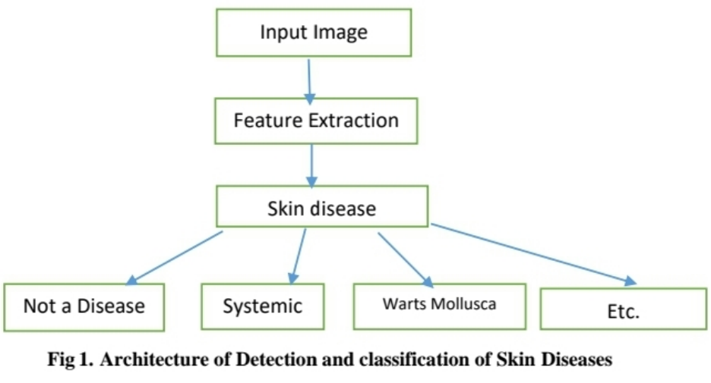
SYSTEM DESIGN

Slide 9
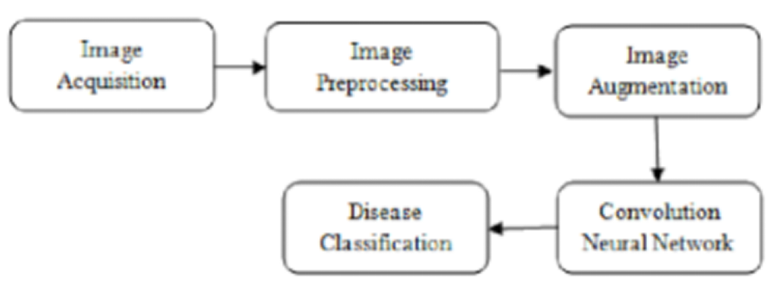
SYSTEM DESIGN
UML DIAGRAM

Slide 10
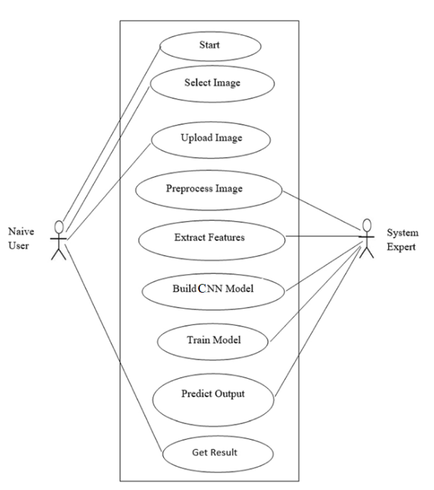
SYSTEM DESIGN
USE CASE DIAGRAM

Slide 11
SYSTEM ANALYSIS
Software Requirements
Python
Django
Mysql
Wampserver
Hardware Requirements
Processor:
Pentium IV or higher
RAM: 256 MB
Space on Hard Disk:
minimum 512MB

Slide 12
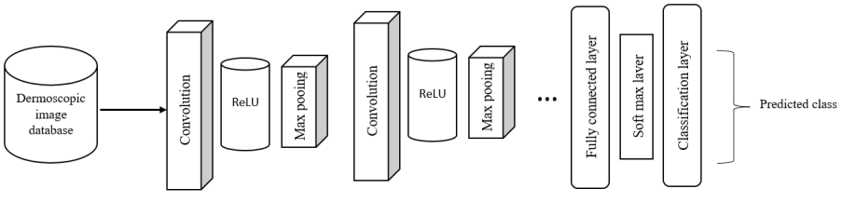
MODULES & WORKING OF CNN
CNN architecture for proposed skin cancer detection and multi-class classification.

Slide 13
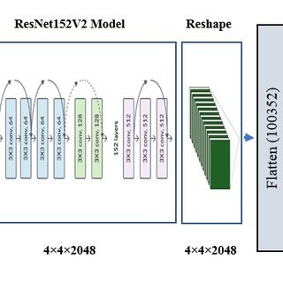
ResNet152V2-architecture

Slide 14
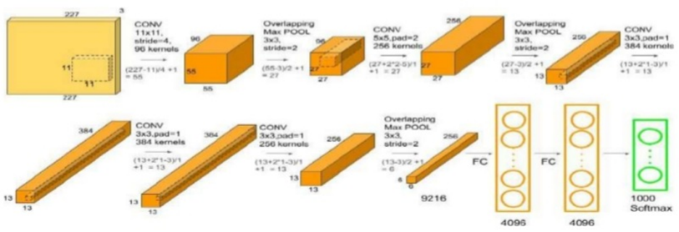
AlexNet

Slide 15
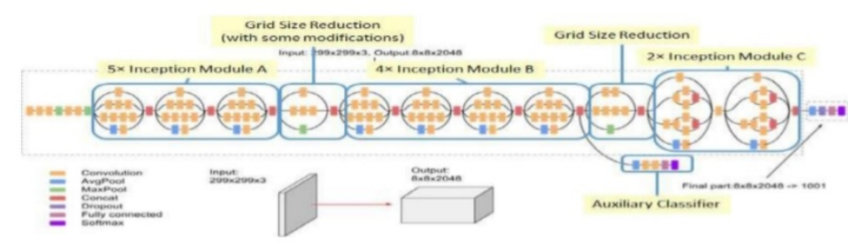
Inception-v3

Slide 16
TESTING
UNIT TESTING
INTEGRATION TESTING
FUNCTIONAL TESTING
SYSTEM TESTING
WHITE BOX TESTING
BLACK BOX TESTING

Slide 17
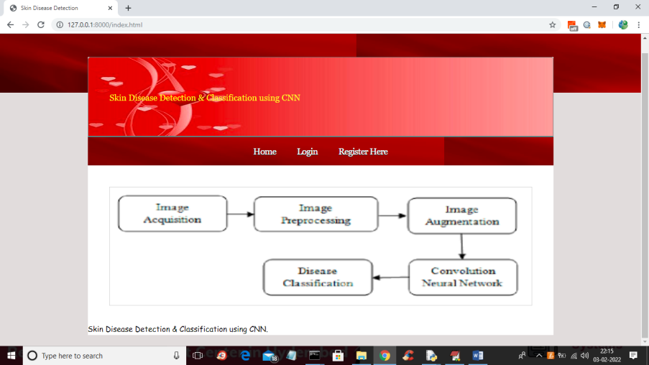
OUTPUT SCREENS

Slide 18
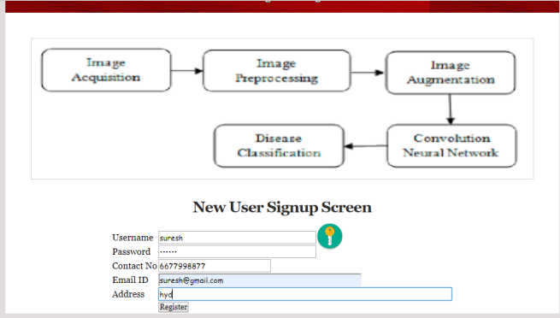

Slide 19
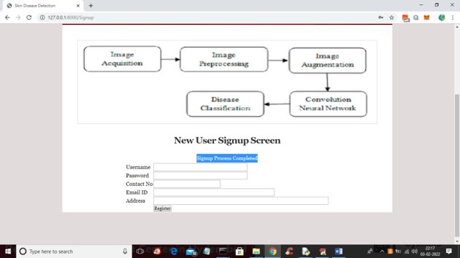

Slide 20
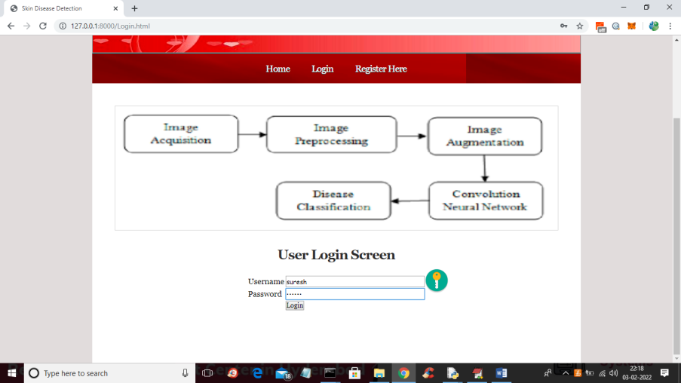

Slide 21
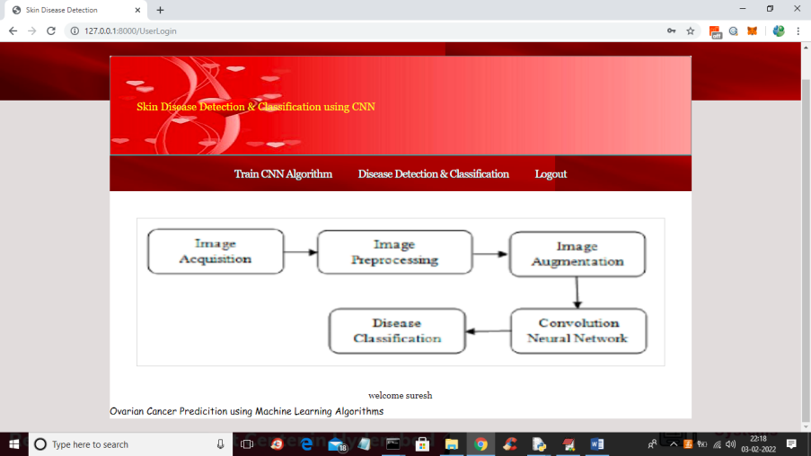

Slide 22
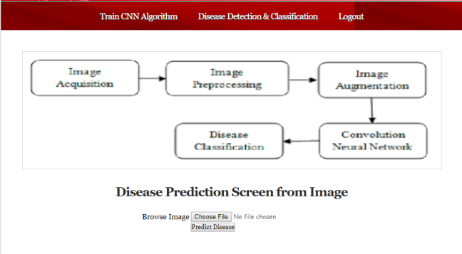

Slide 23
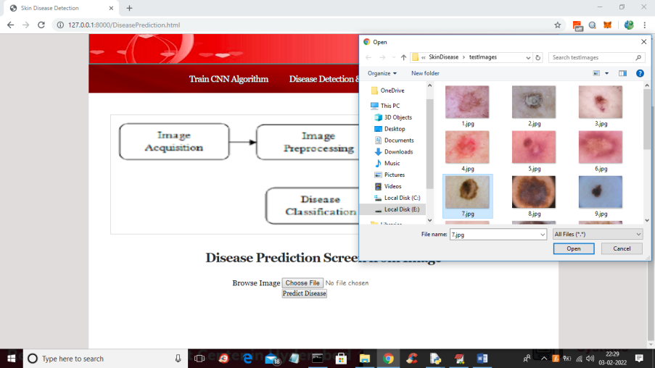

Slide 24
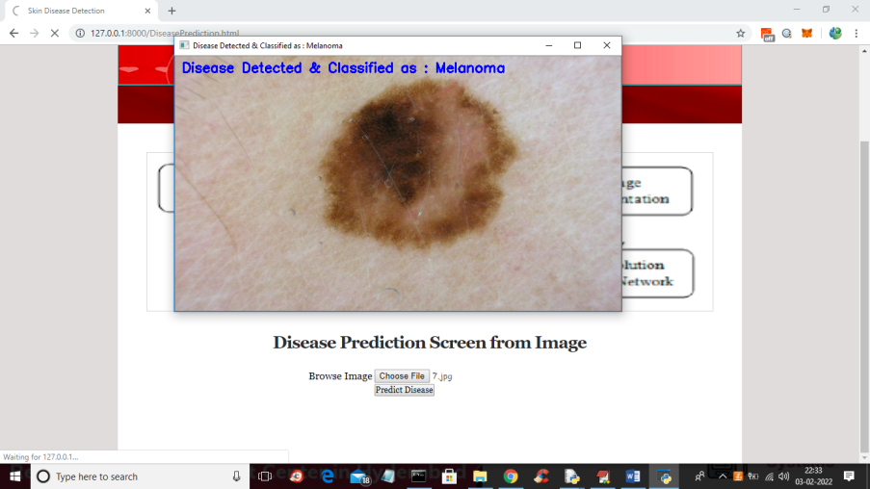

Slide 25
CONCLUSION
The feasibility of building a universal skin disease classification system has been investigated using CNN, Resnet, Alexnet and Inceptionv3. CNN has outperformed over training data but not on testing data. Better accuracy can be obtained by providing a training set with more variance and also by increasing its size. It is also found that Resnet has given better accuracy compared to other networks in the diagnosis of skin diseases

Slide 26
REFERENCES
Sheng Ren, Deepak Kumar Jain, KehuaGuo, Tao Xu,Tao Chi. Towards Efficient Medical Lesion Image Super-Resolution based on Deep
Article Classification of Skin Disease Using Deep Learning Neural Networks with MobileNet V2 and LSTM Parvathaneni Naga Srinivasu
1,† , Jalluri Gnana SivaSai 2 , Muhammad Fazal Ijaz 3,† , Akash Kumar Bhoi 4 , Wonjoon Kim 5,* and James Jin Kang 6,*
Quan Gan,1
and Tao Ji1 , Skin Disease Recognition Method Based on Image Color and Texture Features, Computational and Mathematical
Methods in Medicine / 2018 / Article, Volume 2018

Slide 27


